Slide 1


APP DEVELOPMENT

Slide 2
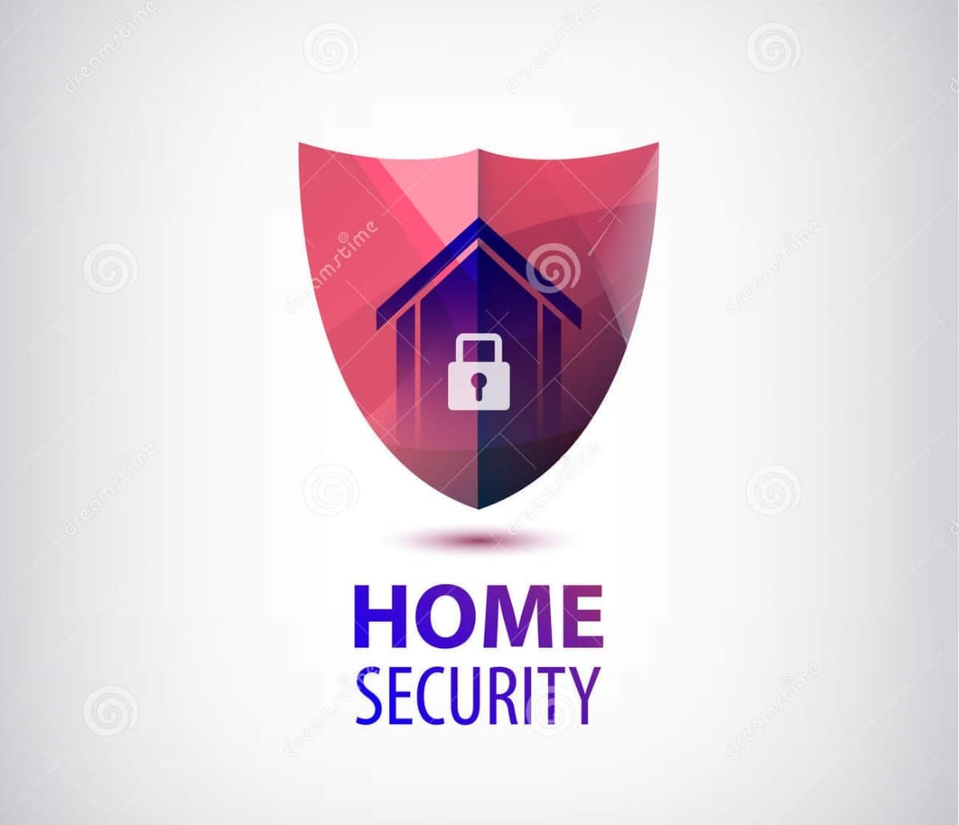
WE CAN CREATE A NEW APP
HOME SECURE APP

Slide 3
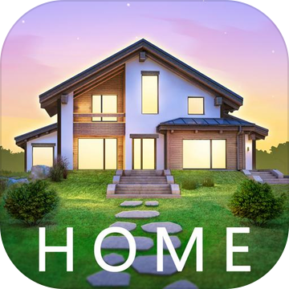
HOME SECURITY SYSTEM
A home security system is a group of physical electronic
Components that all work together to protect a home.
The best home security system offer extensive security
Service that may allow you to feel safer and more
Protected in our home.

Slide 4
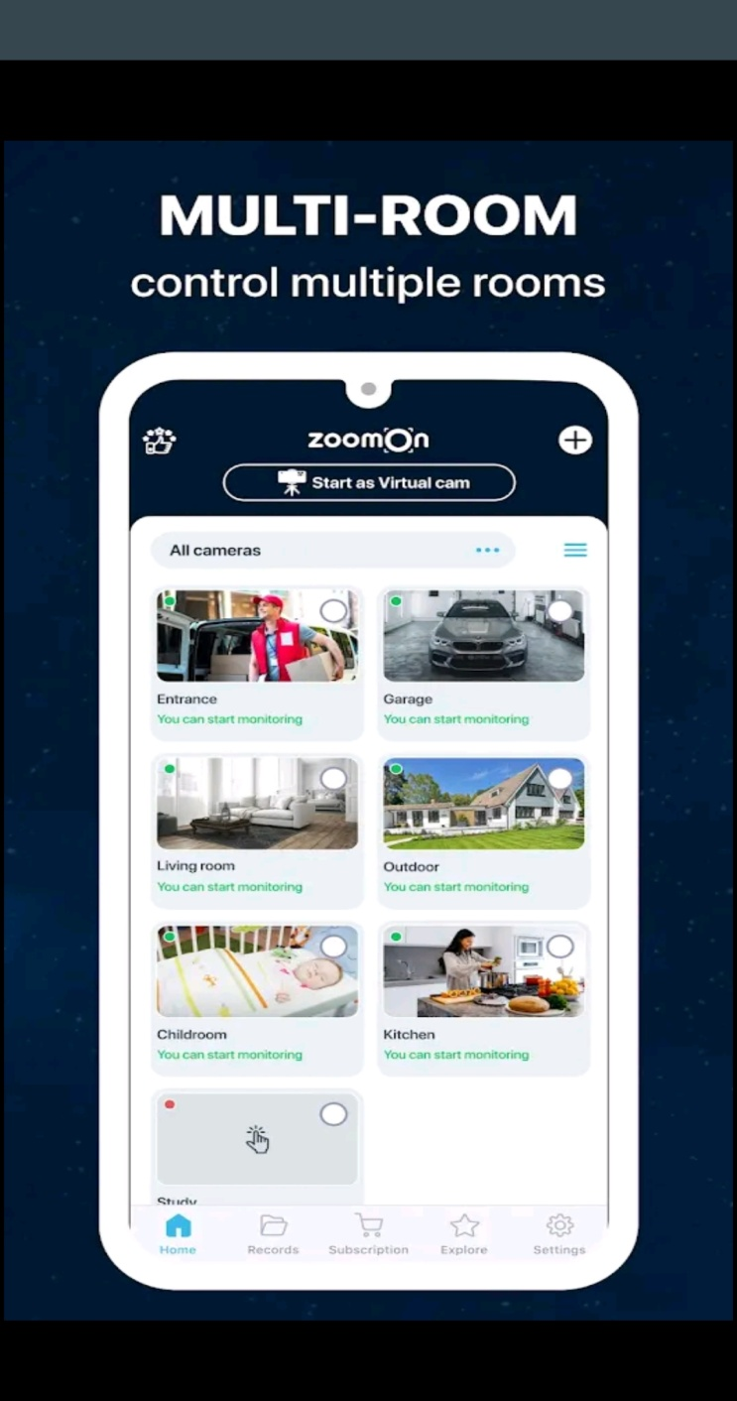
The devices called video multiplexers and digital video recorders (DVRS) or used integrate
visuals from multi video cameras
on a single screen.

Slide 5
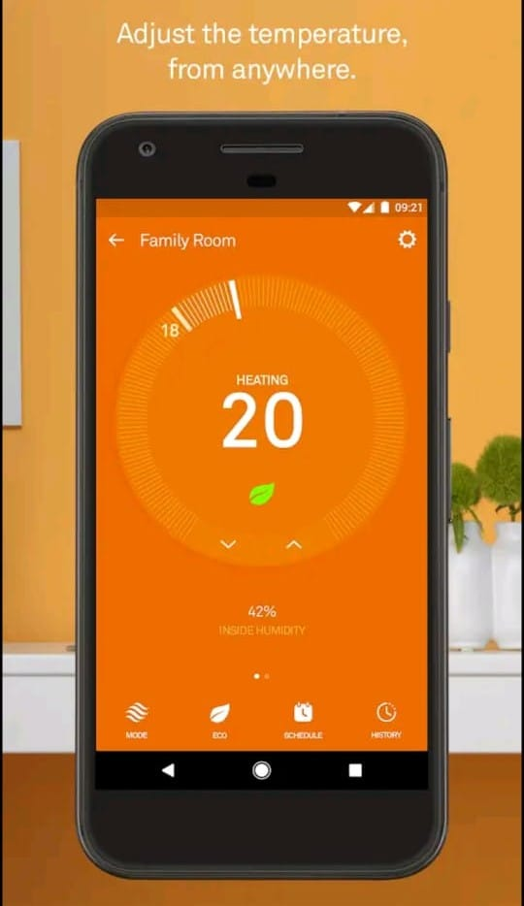
We can easily control our home
Temperature using a smart phone by this home secure app
Control thermostats inside your home

Slide 6
WHY MOBILE MATTERS
Control the locks on your house.
Get instant alerts and notification when you’re away
from home.
Watch CCTV video when you’re not home.
Open and close the garage doors.
Control lights.

Slide 7
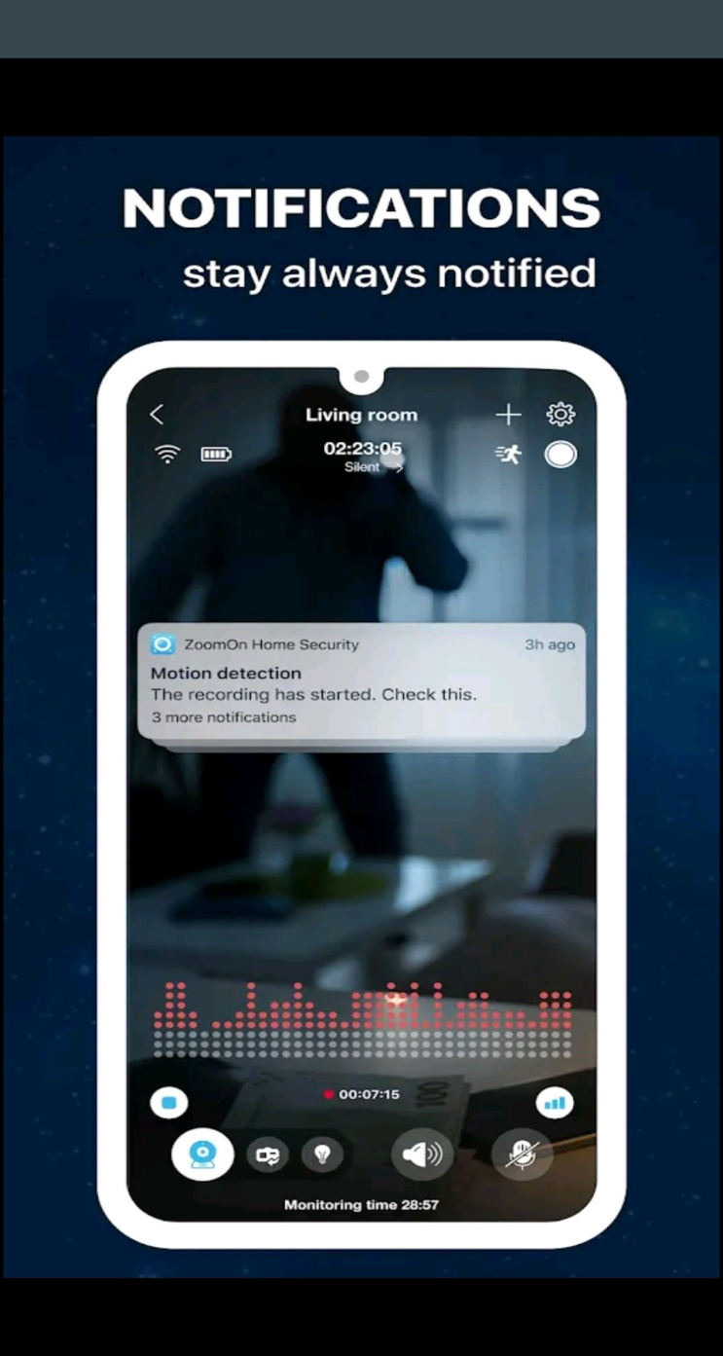
MOTION SENSOR
Motion sensors should be placed
In a main entryway or hallway
on the ground floor of a home so that they can detect motion and alert us when our system is
armed.

Slide 8
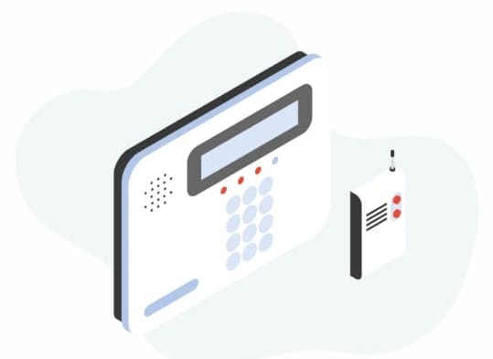
Keypad
To arm are disarms, security
systems commonly required
a code, which we enter on
a keypad that’s mounted
to the wall or placed on a flat
Surface.

Slide 9
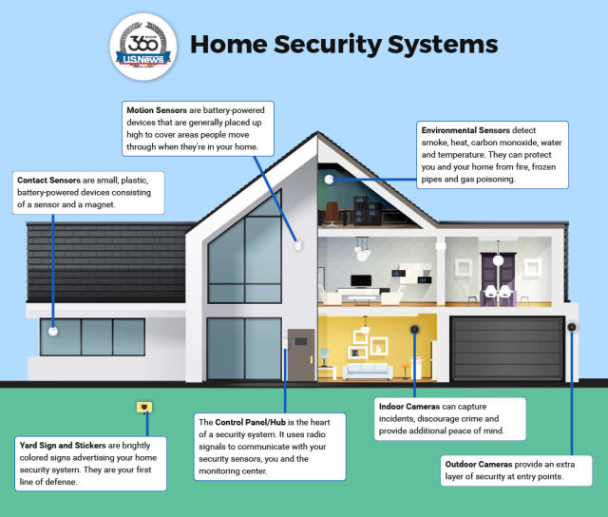
The main purpose of a home security system is to keep our
Property and the people inside it safer.

Slide 10

PRESENTED BY:
R.MADHUMITHA
K.SHARUBINI
IST BSC COMPUTER SCIENCE
SHRIMATHI INDRA GANDHI COLLEGE

